Slide 1
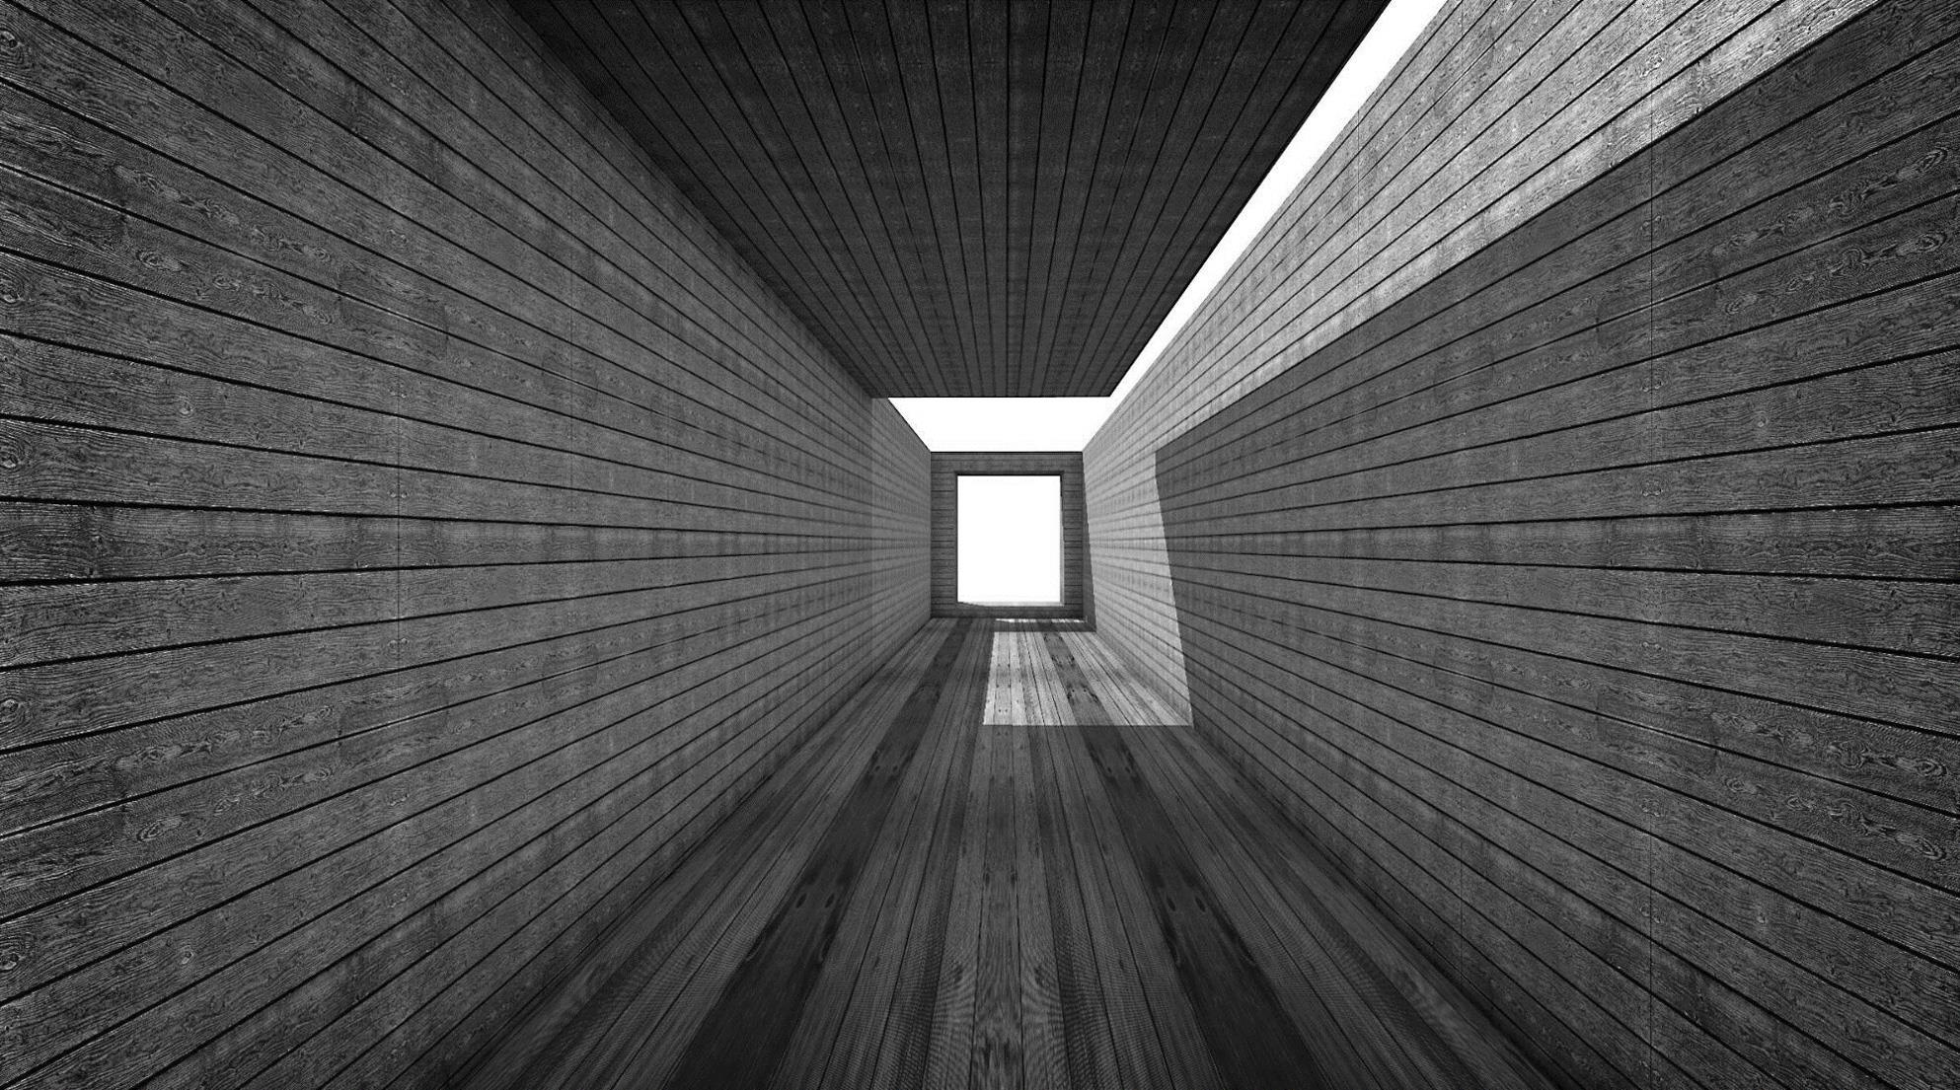
Builder & Prototype Design Patterns

Slide 2


Builder
Builder is a creational design pattern that lets you construct complex objects step by step. The pattern allows you to produce different types and representations of an object using the same construction code.
The solution to customizing the building process

Slide 3
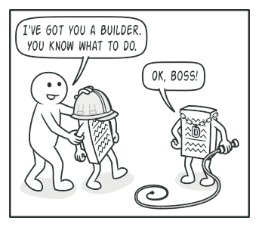
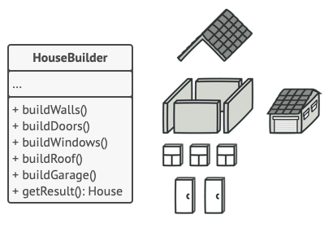
When to use Builder DP
Use the Builder pattern to get rid of a “telescoping constructor”
Use the Builder pattern when you want your code to be able to create different representations of some product (for example, stone and wooden houses).
Use the Builder to construct Composite trees or other complex objects.

Slide 4

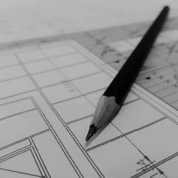
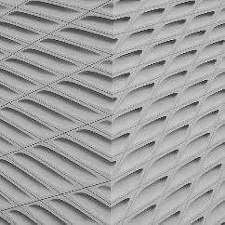

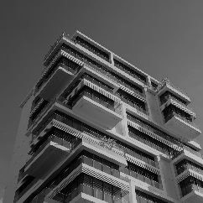




The Problem
Complexity of
Constructor
Absence of
General blueprint
Various Initialization Options

Slide 5
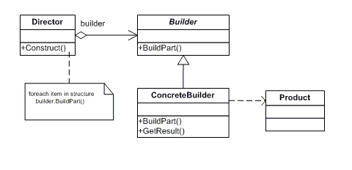
Solution
The Builder pattern suggests that you extract the object construction code out of its own class and move it to separate objects called builders.

Slide 6
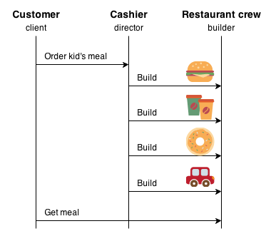
Practical Example
As we can notice, the process of assigning a builder to each stage facilitates the act of various stage-mixing processes.

Slide 7
Prototype
Prototype is a creational design pattern that lets you copy existing objects without making your code dependent on their classes.
The solution to minimizing intitialization code for similar classes

Slide 8
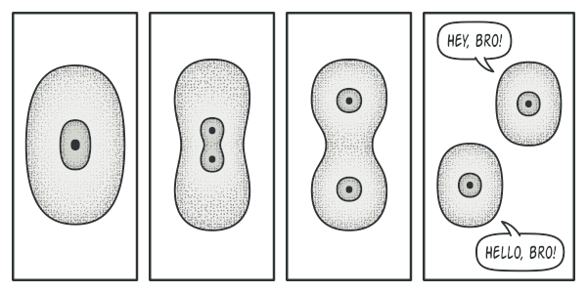
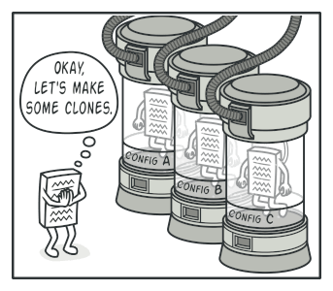
When to use Prototype DP
Use the Prototype pattern when your code shouldn’t depend on the concrete classes of objects that you need to copy.
se the pattern when you want to reduce the number of subclasses that only differ in the way they initialize their respective objects.

Slide 9
The Problem
Complexity of
Constructor
Absence of
General blueprint
Code Repetition

Slide 10
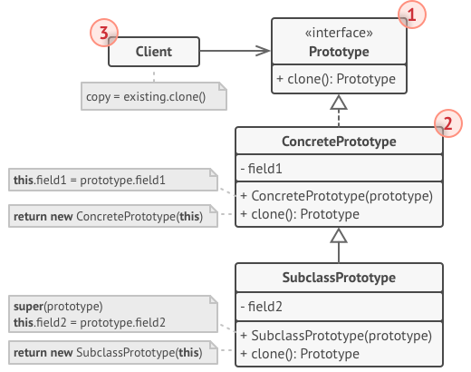
Solution
The Prototype pattern delegates the cloning process to the actual objects that are being cloned. The pattern declares a common interface for all objects that support cloning. This interface lets you clone an object without coupling your code to the class of that object. Usually, such an interface contains just a single clone method.

Slide 11
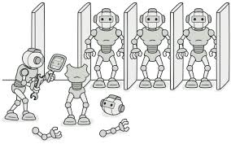
Practical Example
Using the Prototype method the implementation can start from the stages beyond prototyping, and this minimizes a lot of code in every constructor implementation

Slide 12



Thank You
Al-Moshki Esmail
esmailalmoshki@gmail.com

